Slide 1

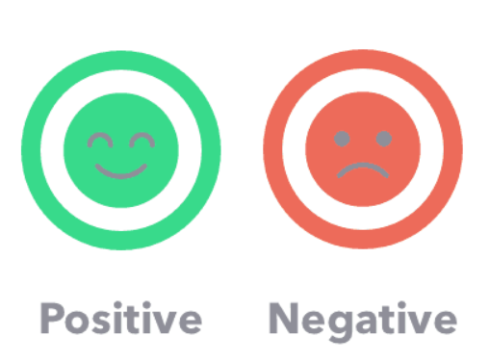

Review Sentiment Prediction
Presented by
Monika Munjal

Slide 2
Problem Statement
The business works and depends on reviews.
Marketing company wants to assess and predict the reviews that they have gathered on their products. Also, Based on the review text provided, stakeholders would like to know whether the feedback has a positive or negative sentiment.
This will help guide decision-making for the firm, as they will want to deep dive into products and improve the feedback— thereby boosting the marketing firm’s reputation.

Slide 3
Data Dictionary
Variable | Description
id | Unique identifier for each tuple
category | The reviews have been categorized into two categories representing positive and negative reviews. 0 represents positive reviews and 1 represents negative reviews.
text | Tokenized text content of the review

Slide 4

Evaluation Metric
Submissions are evaluated using Precision Score.

Slide 5
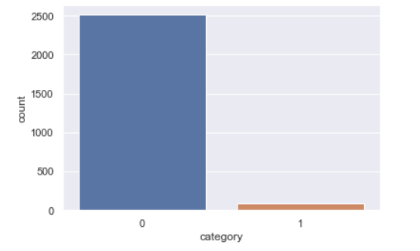
Check for Class Imbalance
0 represents positive reviews and 1 represents negative reviews.
Probability of 0 is 0.97 and 1 is 0.03.

Slide 6
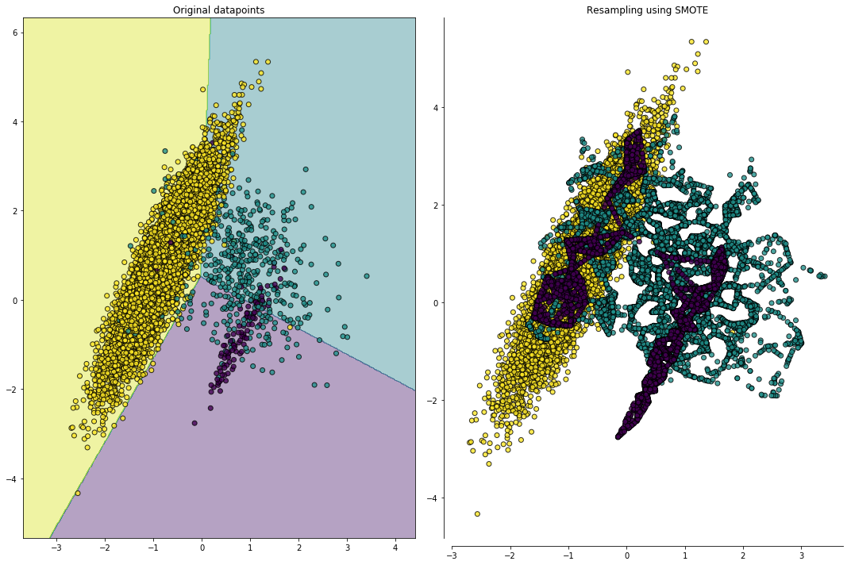
Solution for Class Imbalance- SMOTE
In this technique, the minority class is over-sampled by creating synthetic examples rather than by over-sampling with replacement. It does it by generating synthetic examples in a less application-specific manner i.e. by operating in feature space rather than data space.

Slide 7
Models and Approaches
Models | Precision | Recall | F1-Score
Multinomial NB | 0.94 | 0.97 | 0.95
Gaussian NB | 0.96 | 0.82 | 0.87
Logistic Regression | 0.97 | 0.97 | 0.96
Decision Tree Classifier | 0.96 | 0.97 | 0.96
Random Forest Classifier | 0.97 | 0.97 | 0.96
Voting Classifier with SMOTE | 0.99 | 0.99 | 0.99

Slide 8
Ensemble Technique
A collection of several models working together on a single set is called an ensemble. The method is called Ensemble Learning. It is much more useful use all different models rather than any one.
Why ensembles?
Lower error
Less over-fitting
Taste great

Slide 9
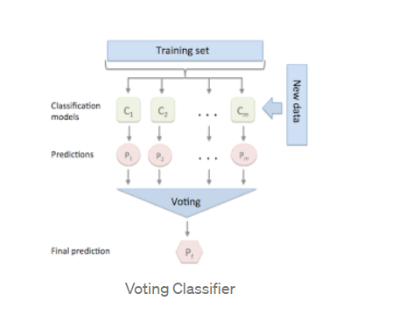
Voting Classifier
Voting is one of the simplest way of combining the predictions from multiple machine learning algorithms. Voting classifier isn’t an actual classifier but a wrapper for set of different ones that are trained and valuated in parallel in order to exploit the different peculiarities of each algorithm.

Slide 10
two types of voting:
Hard Voting: In hard voting, the predicted output class is a class with the highest majority of votes i.e the class which had the highest probability of being predicted by each of the classifiers. Suppose three classifiers predicted the output class(A, A, B), so here the majority predicted A as output. Hence A will be the final prediction.
Soft Voting: In soft voting, the output class is the prediction based on the average of probability given to that class. Suppose given some input to three models, the prediction probability for class A = (0.30, 0.47, 0.53) and B = (0.20, 0.32, 0.40). So the average for class A is 0.4333 and B is 0.3067, the winner is clearly class A because it had the highest probability averaged by each classifier.

Slide 11
Evaluation & Results
Voting Classifier with SMOTE model is giving the best performance among the models considered and is used for the final prediction.
Soft Voting with below classifier has been used for final prediction:
Random Forest Classifier
Multinomial NB
Logistic Regression

Slide 12


